Slide 1
Team PoGo
We are a group of six hardworking individuals having a technical background ,we are undergraduate students completing our majors in electronics engineering.
We have a very good coordination among ourselves , together we have participated in various technical events (uber hacktag, google hashcode).
One of our team member Shutikshan Madhur is the member of GDSC web development team and has great expertise in the web development field and is currently developing GDSC-NSUT website.
Other team members are hardworking and work professionally to learn new skill sets.

Slide 2
Title
Shubham Rastogi (Team Leader)
Himani Dahiya
Yash Gupta
Shubham Pal
Shutikshan Madhur
Priyanshu Singh

Slide 3
Problem
Regular web content updates (Events, Trainings, project Reports, News Articles, Other Docs and Report, Advertisements, Press Releases and News other contents in other pages) couldn't be done as it was static and was purely dependent on the external Developer team
Was not compatible with multi device platform (Desktop / Tab / Mobile)
No social media handles integration.

Slide 4
Problem
Photo Gallery & Video Gallery is not attractive.
Was not user-friendly.
Unavailability of Sitemap.
Unavailability of Search Feature.

Slide 5
Solution
We will make the website responsive and compatible with various devices by using media queries. Some part of certain text were overlapping with each other , so we will work on making the UI of the website better . We will make hamburger menu for making it compatible with small screens. We will also correct the position and placement of the search box .

Slide 6
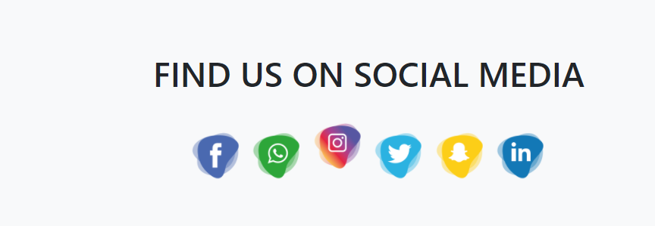
We will integrate all the social media handle of NECBDC like twitter , facebook etc by placing eye catching links of these social media handles. When an user hovers over this link he/she experiences a transition effect and upon clicking it the user is directed to the social media handle.

Slide 7
We will improve the video and photo gallery by improving the css and adding some animations in it.
We will try our best to make the website eye catching .
We will make the navbar of the website sticky for improving user experience .
We will implement the search box.
We will also update the contact page of the website.

Slide 8
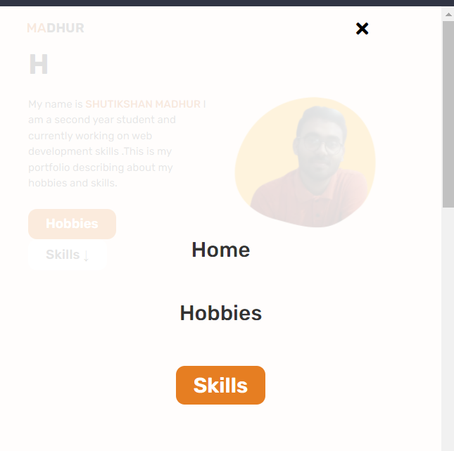
Redesigning of the hamburger menu to make the website responsive

Slide 9
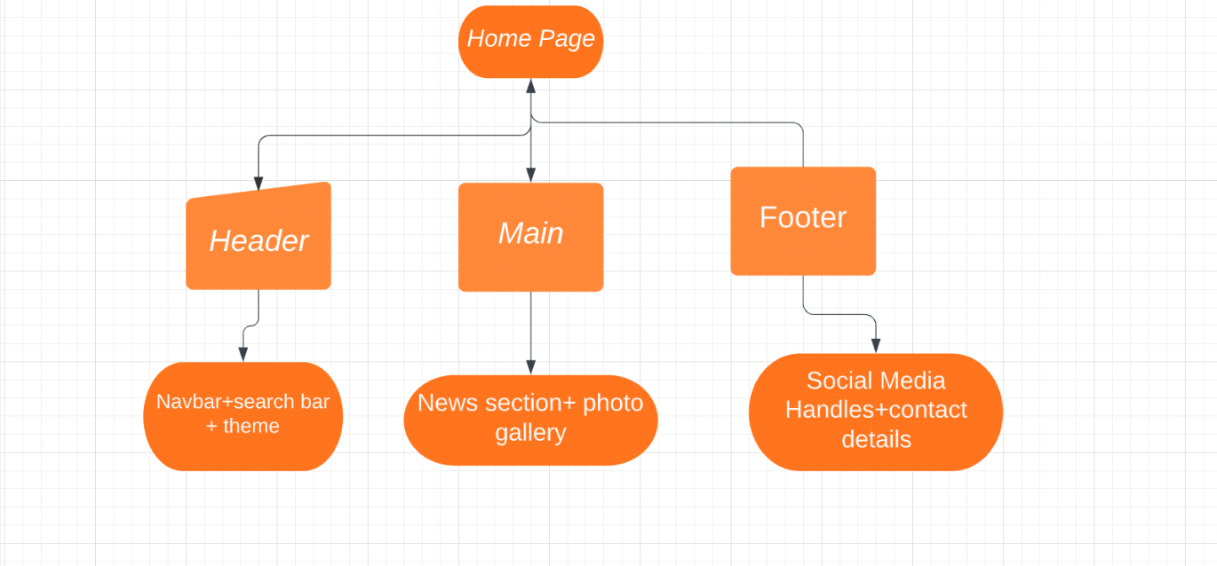
Flowchart

